Slide 1

VAST chanllenge, 2016
Group HANDSOME Prof Qu
TANG CAN-YAO
WANY Ziqi
DOU Daihui
WANY Wenlong

Slide 2


Project background
GAStech new building
The new office is built to the highest energy efficiency standards, and it is fully instrumented with sensors that identify everything from building temperatures to concentration levels of various chemicals(Hazium,Carbon dioxide).
GAStech new policy
GAStech introduced new security procedures. Staff members are required to wear proximity (prox) cards while in the building. The building is instrumented with passive prox card readers that cover individual building zones.

Slide 3
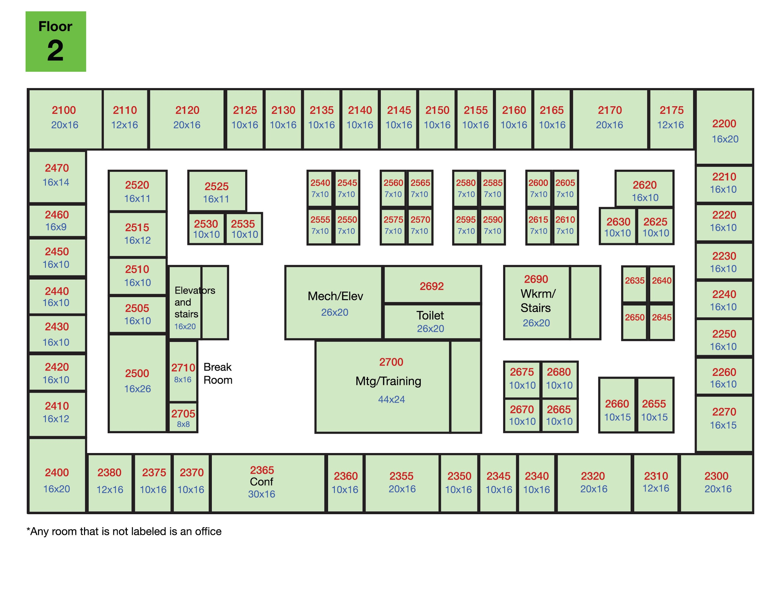
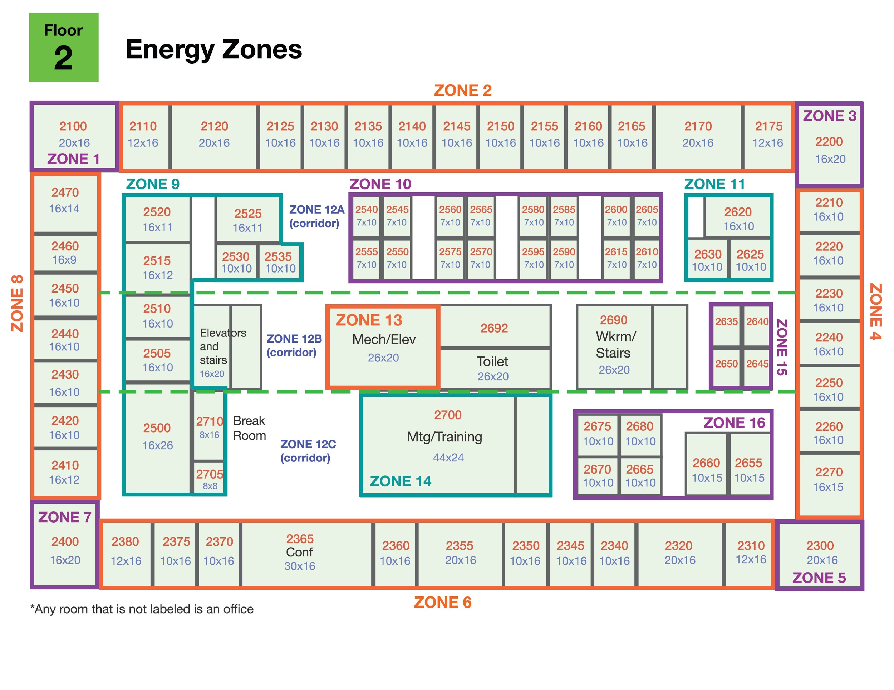
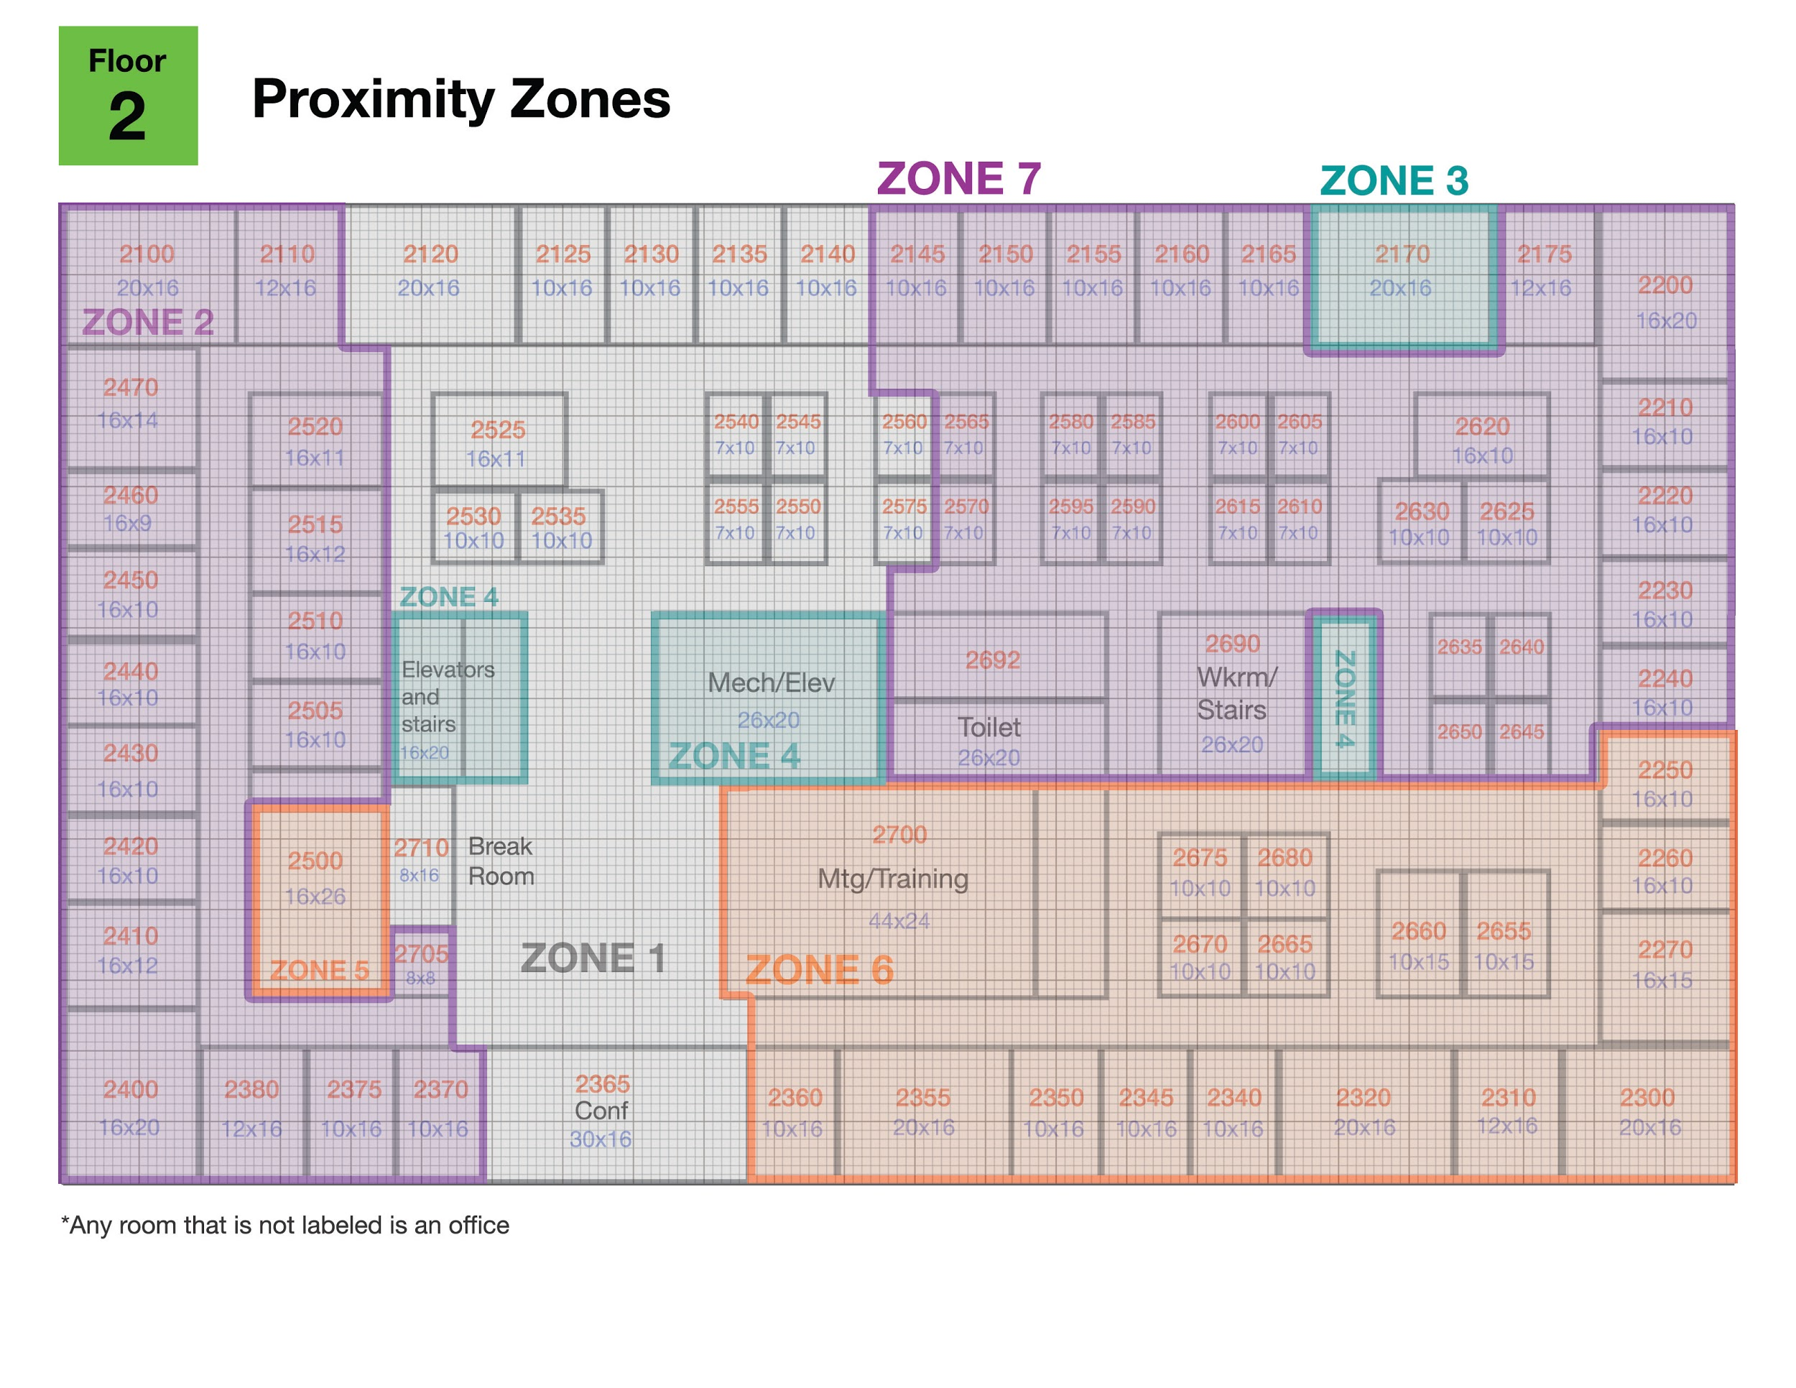
General structure of the data
We are require to help the GAStech better understand it’s operation with its two week’s building and proximity sensor data. Below is list of the data provided.
A building layout for the GAStech offices, including the maps of the prox zones and the HVAC zones
A current list of employees, roles, and office assignments
Proximity sensor data for each of the prox zone regions
Proximity sensor data from Rosie the mobile robot
HVAC sensor readings and status information from each of the building’s HVAC zones
Hazium readings from four sensors

Slide 4
Design requirement & tasks
What are the typical patterns in the prox card data? What does a typical day look like for GAStech employees?
Describe up to ten of the most interesting patterns that appear in the building data. Describe what is notable about the pattern and explain its possible significance.
Describe up to ten notable anomalies or unusual events you see in the data. Prioritize those issues that are most likely to represent a danger or a serious issue for building operations.
Describe up to five observed relationships between the proximity card data and building data elements. If you find a causal relationship (for example, a building event or condition leading to personnel behavior changes or personnel activity leading to building operations changes), describe your discovered cause and effect, the evidence you found to support it, and your level of confidence in your assessment of the relationship.

Slide 5
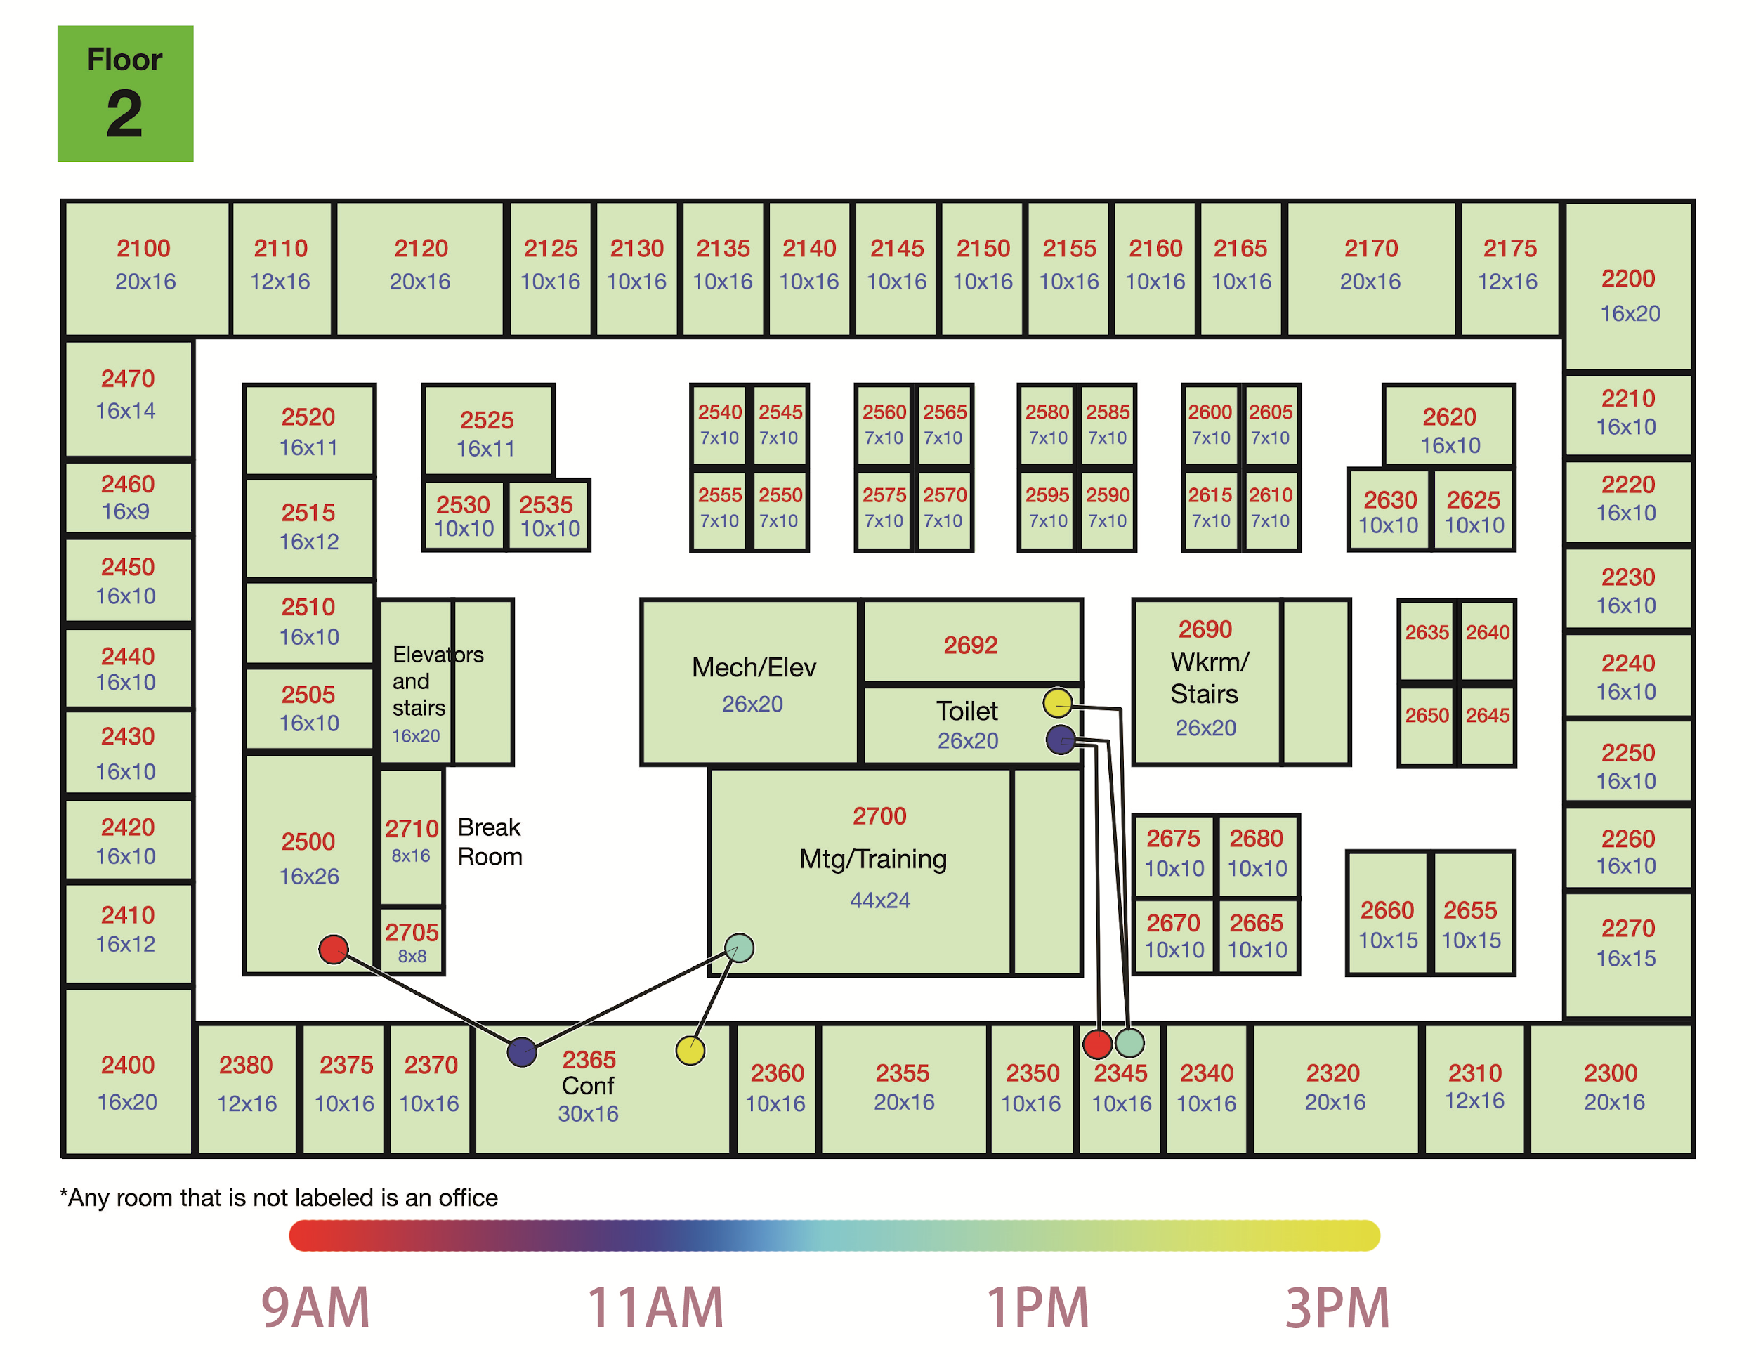
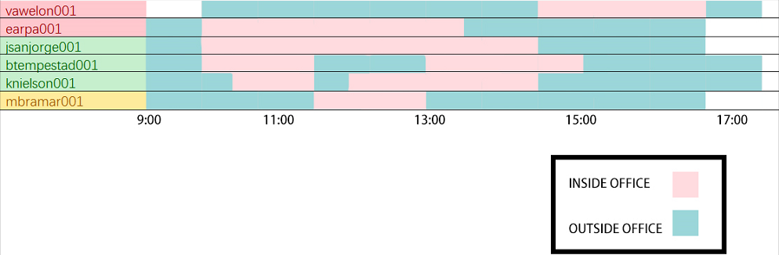
Visualization design(Employee data)
Below is the Gantt chart for all the employee
Above is the floor map each circle represents an employee and different color represents different department
The trajectory of each employee can be shown by moving the index along the Gantt Chart
Display individual employee or a group of employee trajectory is possible by choosing the corresponding employee

Slide 6
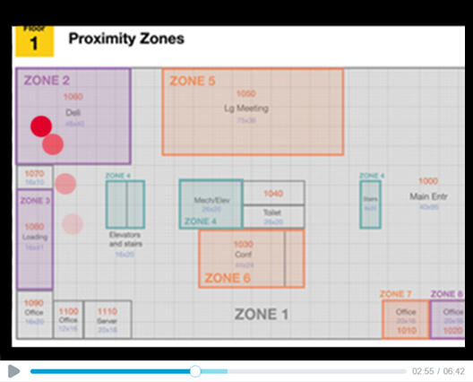
Alternative design
Using animation to present the movement of the employee
Disavantage:
Eyes beat memory

Slide 7
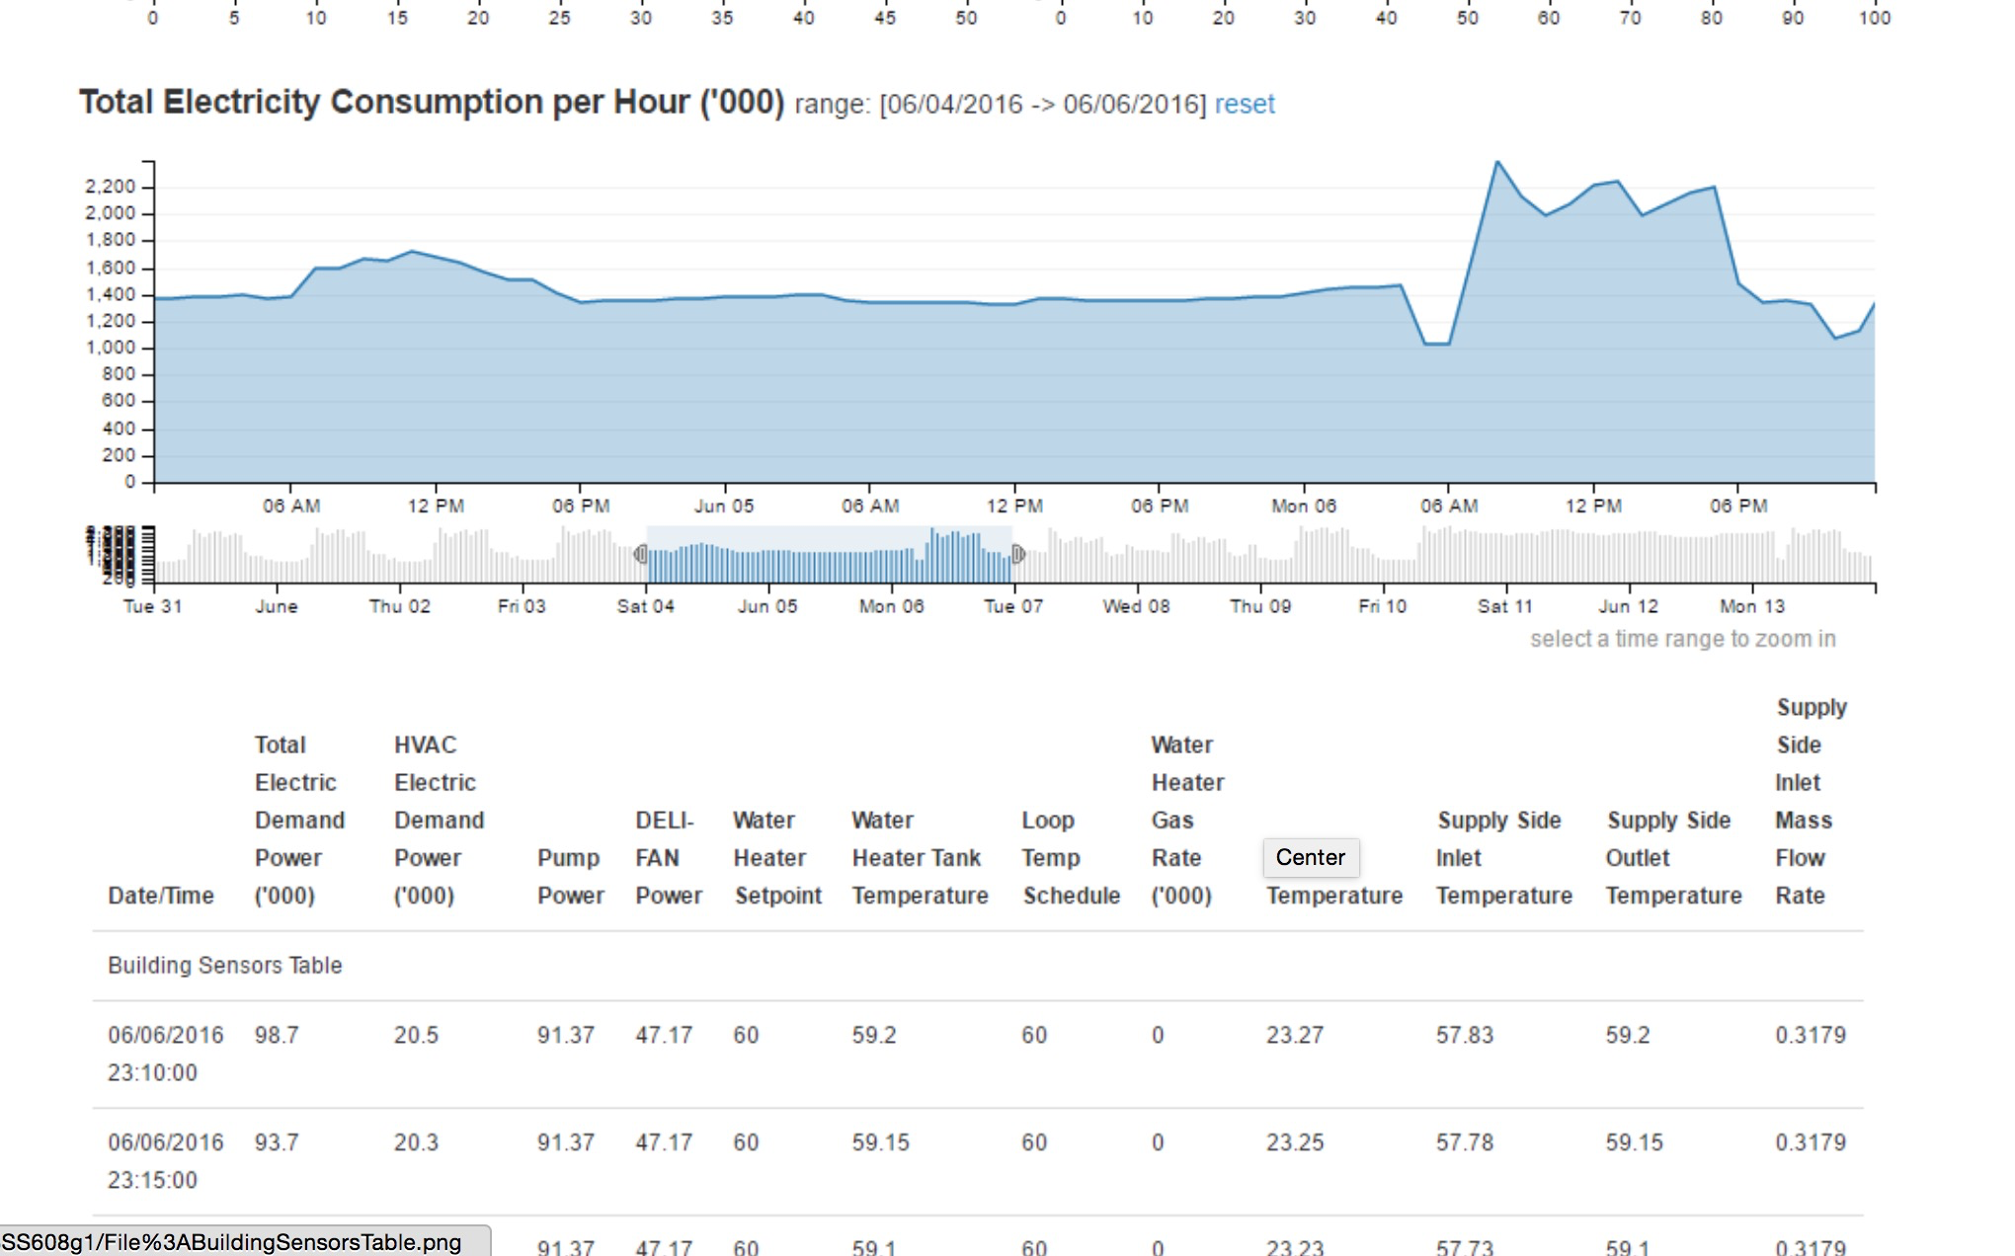
Visualization design (Overall building data)
Select a certain time slot from the timeline, to represent the data in a certain time slot.
Select an attribute, so that data on this attribute can be showed on the graph.

Slide 8
Alternative design
Put everything in one graph. Use different colors of lines to encode different atrributes.
Disadvantage:
The attributes have little correlation and would mess up the graph.

Slide 9
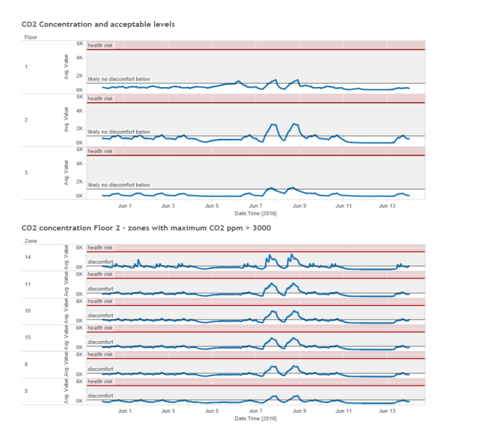
Visualization design(HVAC Zone data)
X-axis represents the time
Y-axis represents the amount of chemical components
Data is seperated into different floor
Each sensor has it own graph

Slide 10
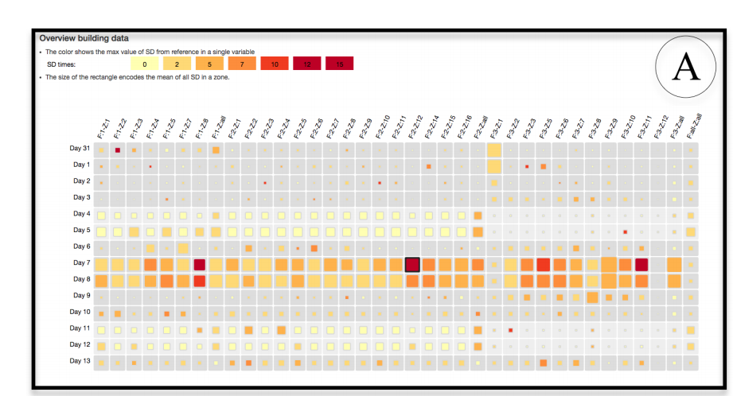
Alternative design
Heat Map
Color shows the max value
Size shows the mean value
Disavantage:
Separate timeline
Not obvious trend

